Slide 1


ADMIS Lab
先进数据与机器智能系统实验室
Query Processing/查询处理
Chapter 15
Yichao Zhang
Email: yichaozhang@tongji.edu.cn
Department of Computer Science and Technology
Tongji University

Slide 2
Outline
Overview
Measures of Query Cost
Selection Operation
Sorting
Join Operation
Other Operations
Evaluation of Expressions

Slide 3
查询处理的基本步骤

Slide 4
查询处理的基本步骤
语法分析与翻译/Parsing and translation
  Translate the query into the internal form which is then translated into relational algebra
优化/Optimization
  Generate the optimal execution plan (执行计划)
执行/Execution
  The query execution engine executes the execution plan, and returns the answers to the query

Slide 5
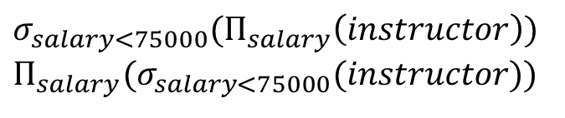
查询优化
对应的关系代数表达式
select salary
from instructor
where salary < 75000
$$σ_{salary<75000}(Π_{salary}\left(instructor\right))$$
$$Π_{salary}(σ_{salary<75000}(instructor))$$
A relational algebra expression may have many equivalent expressions

Slide 6
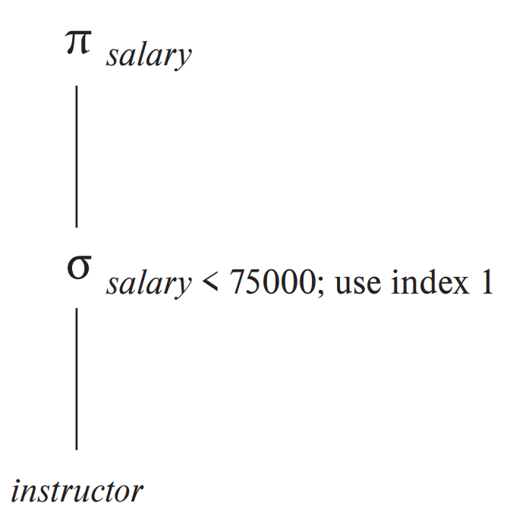
查询优化（续）
查询执行计划/Query execution plan
  Annotated expression specifying detailed execution strategy

Slide 7
查询优化（续）
Query Optimization
  Amongst all the equivalent evaluation plans, choose the one with the lowest cost
  Cost is estimated using statistical information from the database catalog
This chapter
  How to measure query costs
  Algorithms for evaluating relational algebra operations
  Combine algorithms for individual operations to evaluate a complete expression
Next chapter
  The way to find an execution plan with the lowest estimated cost

Slide 8
Outline
Overview
Measures of Query Cost
Selection Operation
Sorting
Join Operation
Other Operations
Evaluation of Expressions

Slide 9
查询代价度量
Cost is generally measured as the total elapsed time for answering the query
  disk accesses, CPU, and even network communication
Typically disk access is the predominant cost, and is also relatively easy to be estimated
Disk access is measured by taking into account
  Number of seeks
  Number of blocks read
  Number of blocks written

Slide 10
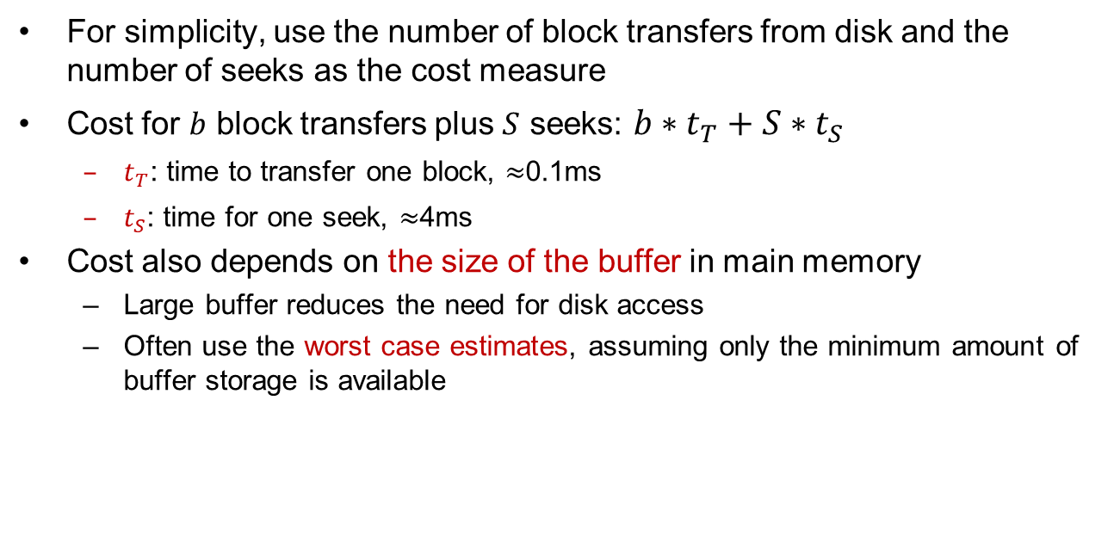
查询代价度量（续）
For simplicity, use the number of block transfers from disk and the number of seeks as the cost measure
Cost for $b$ block transfers plus $S$ seeks: $b∗t_{T}+S∗t_{S}$
  $t_{T}$: time to transfer one block, $≈$0.1ms
  $t_{S}$: time for one seek, $≈$4ms
Cost also depends on the size of the buffer in main memory
  Large buffer reduces the need for disk access
  Often use the worst case estimates, assuming only the minimum amount of buffer storage is available

Slide 11
Outline
Overview
Measures of Query Cost
Selection Operation
Sorting
Join Operation
Other Operations
Evaluation of Expressions

Slide 12
Selection Operation/选择运算
File scan (文件扫描)
  Search algorithms that locate and retrieve records that satisfy a selection condition
Index scan (索引扫描)
  Search algorithms that use an index
  Selection condition must be on search-key of an index
Notes:
availability of indices：索引的可用性，即搜索的关键词是否被索引过

Slide 13
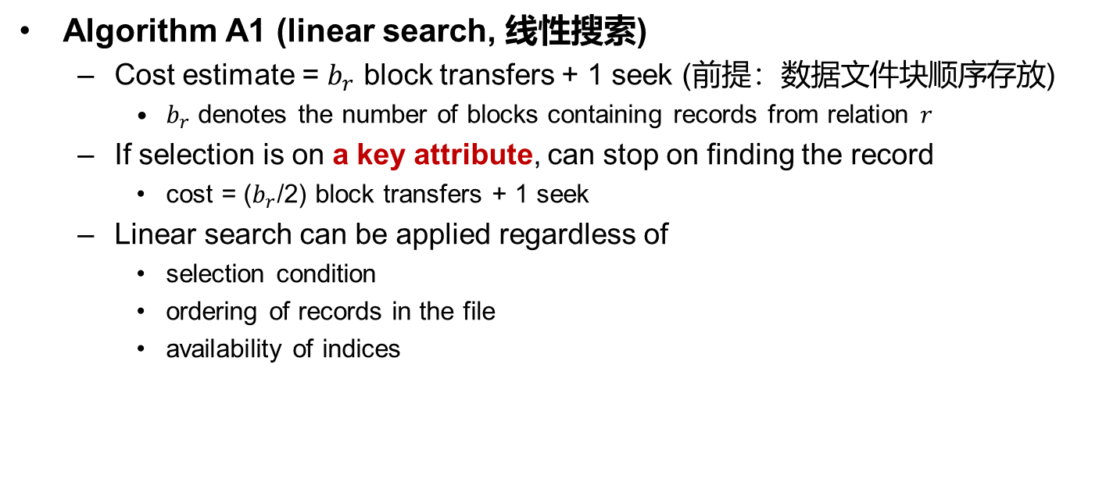
选择运算
Algorithm A1 (linear search, 线性搜索)
  Cost estimate = $b_{r}$ block transfers + 1 seek (前提：数据文件块顺序存放)
    $b_{r}$ denotes the number of blocks containing records from relation $r$
  If selection is on a key attribute, can stop on finding the record
    cost = ($b_{r}$/2) block transfers + 1 seek
  Linear search can be applied regardless of
    selection condition
    ordering of records in the file
    availability of indices

Slide 14
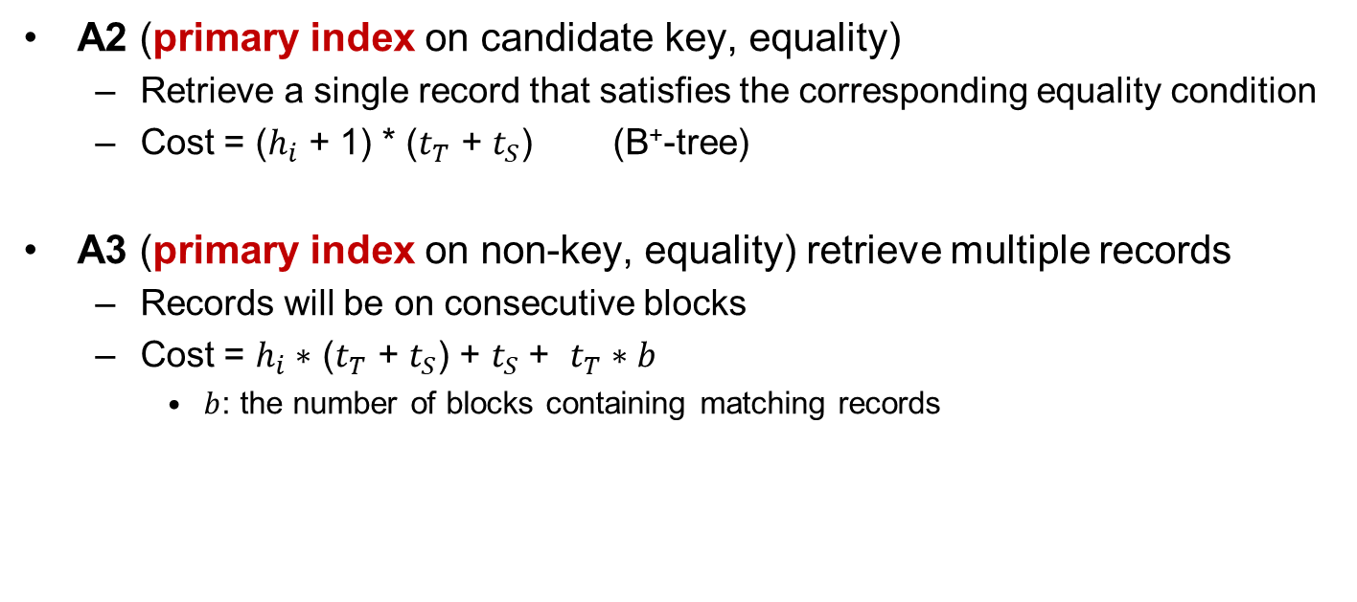
Selections using Indices
A2 (primary index on candidate key, equality)
  Retrieve a single record that satisfies the corresponding equality condition
  Cost = ($h_{i}$ + 1) * ($t_{T}$ + $t_{S}$) (B⁺-tree)
A3 (primary index on non-key, equality) retrieve multiple records
  Records will be on consecutive blocks
  Cost = $h_{i}∗$ ($t_{T}$ + $t_{S}$) + $t_{S}$+ $t_{T}∗b$
    $b$: the number of blocks containing matching records

Slide 15
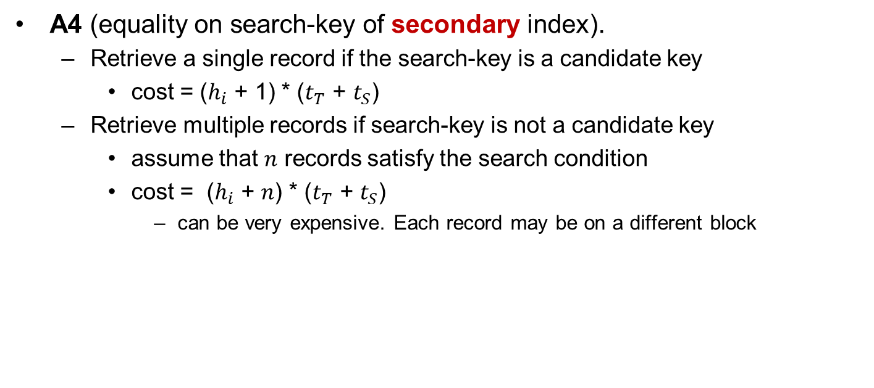
Selections using Indices (Cont.)
A4 (equality on search-key of secondary index).
  Retrieve a single record if the search-key is a candidate key
    cost = ($h_{i}$ + 1) * ($t_{T}$ + $t_{S}$)
  Retrieve multiple records if search-key is not a candidate key
    assume that $n$ records satisfy the search condition
    cost = ($h_{i}$ + $n$) * ($t_{T}$ + $t_{S}$)
      can be very expensive. Each record may be on a different block

Slide 16
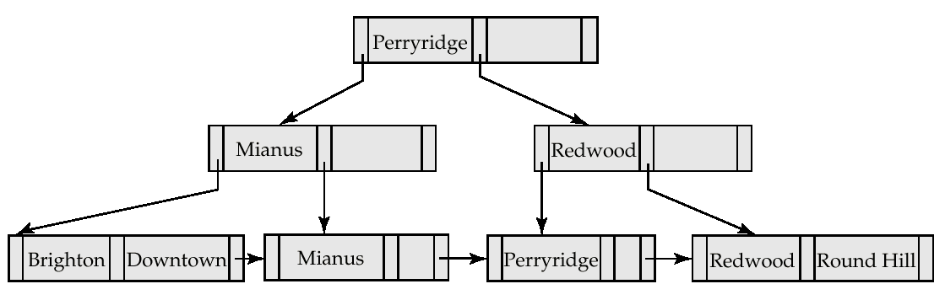
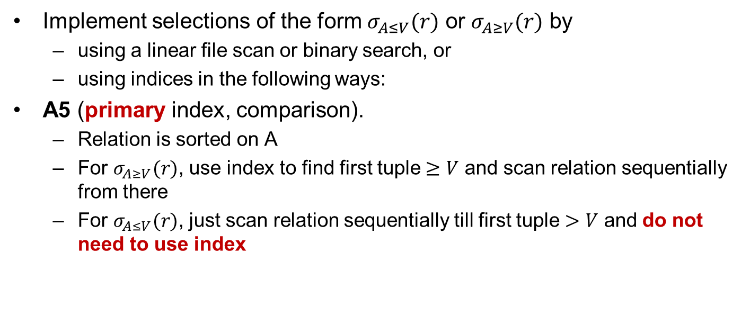
Selections Involving Comparisons
Implement selections of the form $σ_{A≤V}(r)$ or $σ_{A≥V}(r)$ by
  using a linear file scan or binary search, or
  using indices in the following ways:
A5 (primary index, comparison).
  Relation is sorted on A
  For $σ_{A≥V}(r)$, use index to find first tuple $≥V$ and scan relation sequentially from there
  For $σ_{A≤V}(r)$, just scan relation sequentially till first tuple $>V$ and do not need to use index

Slide 17
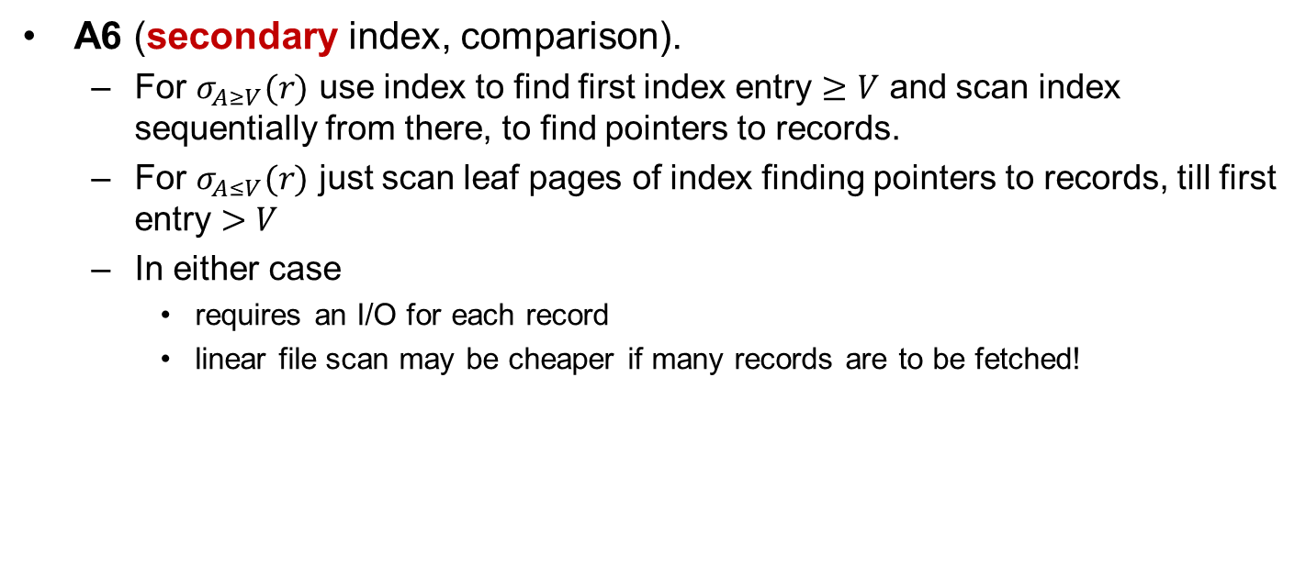
Selections Involving Comparisons (Cont.)
A6 (secondary index, comparison).
  For $σ_{A≥V}(r)$ use index to find first index entry $≥V$ and scan index sequentially from there, to find pointers to records.
  For $σ_{A≤V}(r)$ just scan leaf pages of index finding pointers to records, till first entry $>V$
  In either case
    requires an I/O for each record
    linear file scan may be cheaper if many records are to be fetched!

Slide 18
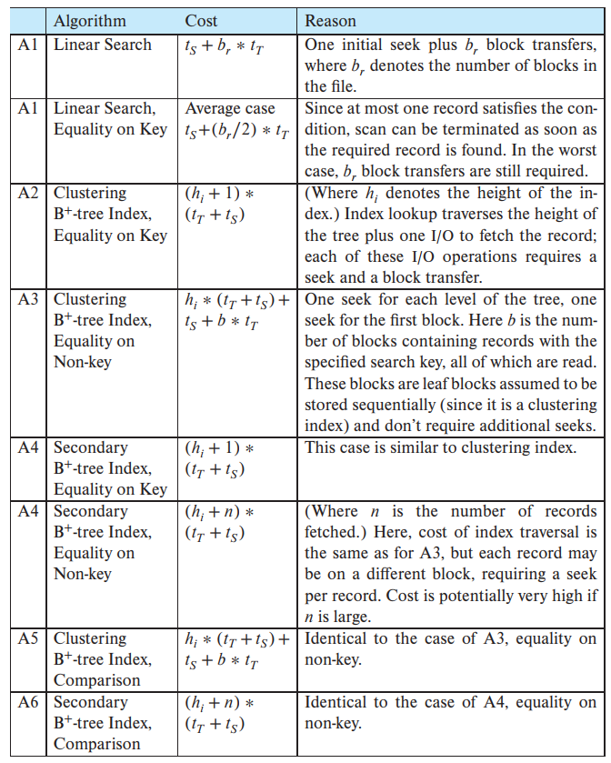
Selection Operation Cost Estimation

Slide 19
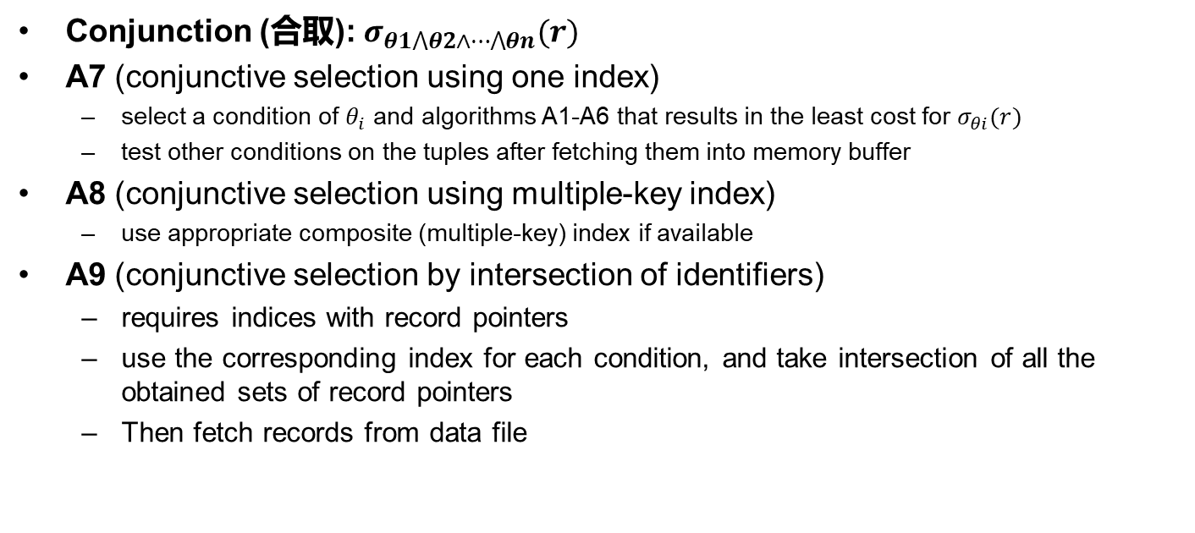
复杂选择的实现
Conjunction (合取): $σ_{θ1⋀θ2∧⋯⋀θn}(r)$
A7 (conjunctive selection using one index)
  select a condition of $θ_{i}$ and algorithms A1-A6 that results in the least cost for $σ_{θi}(r)$
  test other conditions on the tuples after fetching them into memory buffer
A8 (conjunctive selection using multiple-key index)
  use appropriate composite (multiple-key) index if available
A9 (conjunctive selection by intersection of identifiers)
  requires indices with record pointers
  use the corresponding index for each condition, and take intersection of all the obtained sets of record pointers
  Then fetch records from data file

Slide 20
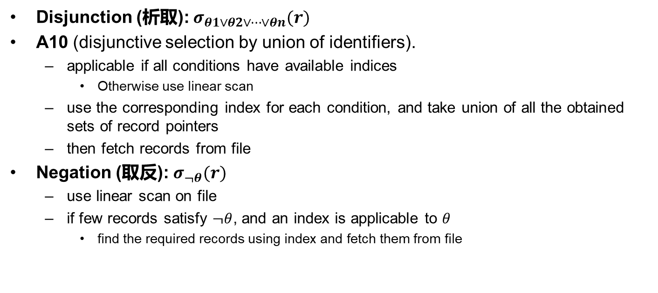
复杂选择的实现（续）
Disjunction (析取): $σ_{θ1∨θ2∨⋯∨θn}(r)$
A10 (disjunctive selection by union of identifiers).
  applicable if all conditions have available indices
    Otherwise use linear scan
  use the corresponding index for each condition, and take union of all the obtained sets of record pointers
  then fetch records from file
Negation (取反): $σ_{¬θ}(r)$
  use linear scan on file
  if few records satisfy $¬θ$, and an index is applicable to $θ$
    find the required records using index and fetch them from file

Slide 21
Outline
Overview
Measures of Query Cost
Selection Operation
Sorting
Join Operation
Other Operations
Evaluation of Expressions

Slide 22
Sorting
Build an index on the relation, and then use the index to read the relation in sorted order.
  May lead to one disk block access for each tuple for non-primary indices
Relations that fit in memory
  Quick-sort (快速排序)
Relations that don’t fit in memory
  External sort-merge (外排序-归并)

Slide 23
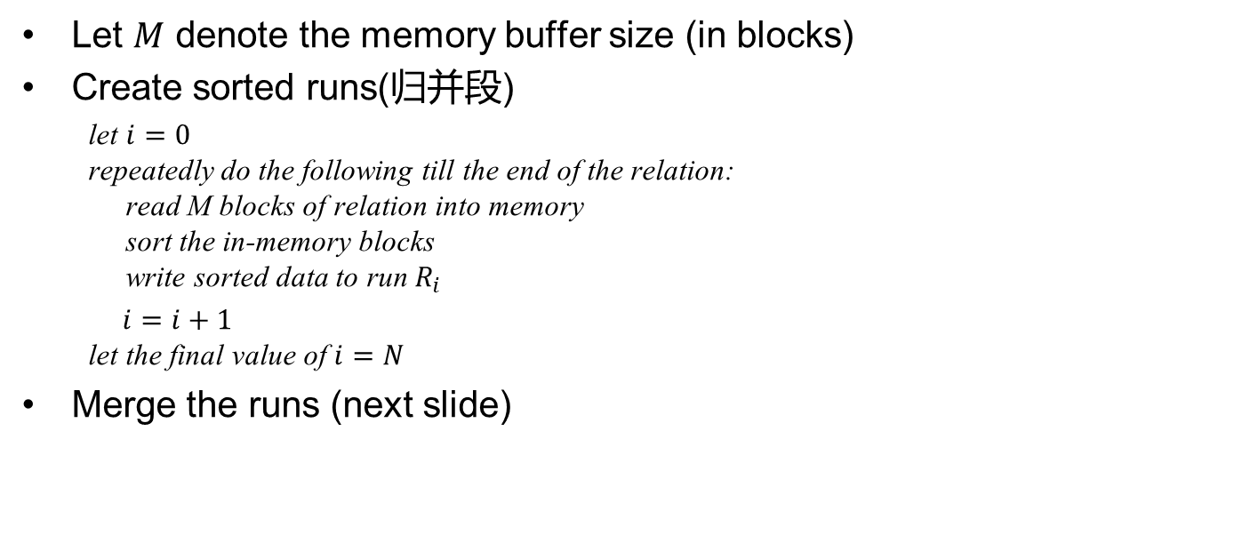
External Sort-Merge (外排序-归并)
Let $M$ denote the memory buffer size (in blocks)
Create sorted runs(归并段)
  let $i=0$
  repeatedly do the following till the end of the relation:
  read M blocks of relation into memory
  sort the in-memory blocks
  write sorted data to run $R_{i}$
  $i=i+1$
  let the final value of $i=N$
Merge the runs (next slide)

Slide 24
外排序-归并（续）
Merge the runs (N-way merge, N路归并) and assume N < M
  Use N blocks of memory to buffer input runs, and 1 block to buffer output. Read the first block of each run into its buffer page
  repeat
    select the first record (in sort order) among all buffer blocks
    write the record to the output buffer block
    if the output buffer is full, write it to disk
    delete the record from the input buffer block
    If the buffer block becomes empty then
    read the next block of the run into the buffer
  until all input buffer blocks are empty

Slide 25
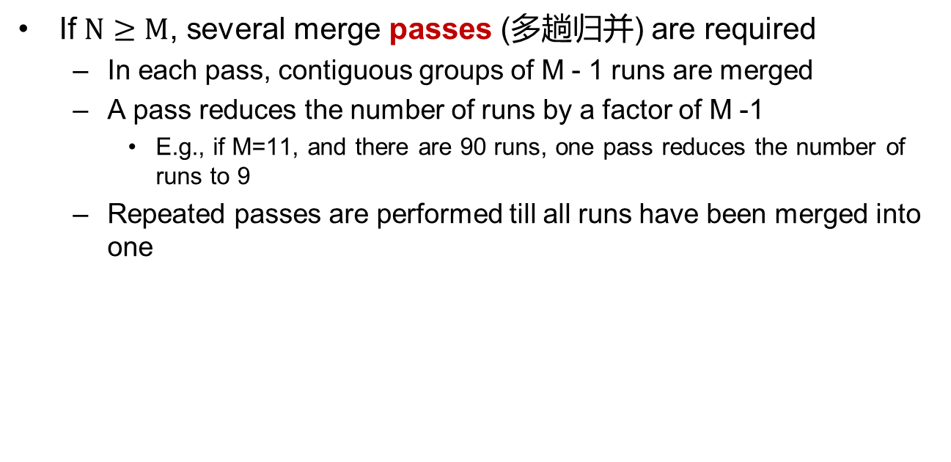
外排序-归并（续）
If $N≥M$, several merge passes (多趟归并) are required
  In each pass, contiguous groups of M - 1 runs are merged
  A pass reduces the number of runs by a factor of M -1
    E.g., if M=11, and there are 90 runs, one pass reduces the number of runs to 9
  Repeated passes are performed till all runs have been merged into one

Slide 26
外排序-归并（续）
Sort on the first column!
Assume:
Only one tuple fits in a block
Memory holds at most 3 blocks, 2 for input and 1 for output

Slide 27
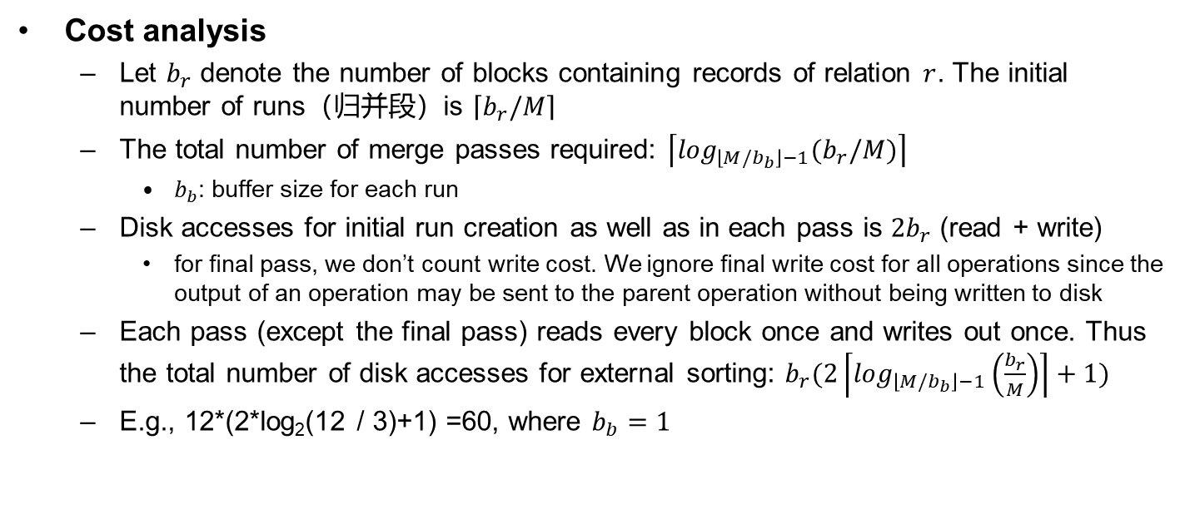
外排序-归并（续）
Cost analysis
  Let $b_{r}$ denote the number of blocks containing records of relation $r$. The initial number of runs（归并段）is $\left\lceil b_{r}/M\right\rceil$
  The total number of merge passes required: $\left\lceil \log_{\left\lfloor M/b_{b}\right\rfloor −1}(b_{r}/M)\right\rceil$
    $b_{b}$: buffer size for each run
  Disk accesses for initial run creation as well as in each pass is $2b_{r}$ (read + write)
    for final pass, we don’t count write cost. We ignore final write cost for all operations since the output of an operation may be sent to the parent operation without being written to disk
  Each pass (except the final pass) reads every block once and writes out once. Thus the total number of disk accesses for external sorting: $b_{r}(2\left\lceil \log_{\left\lfloor M/b_{b}\right\rfloor −1}\left(\frac{b_{r}}{M}\right)\right\rceil +1)$
  E.g., 12*(2*log₂(12 / 3)+1) =60, where $b_{b}=1$
Notes:
read和write各需要$b_{r}$次磁盘访问，因此总共需要$2b_{r}$次磁盘访问。如果只计算read，例如最后一轮，那就只需要$b_{r}$次磁盘访问。注意：$2b_{r}\left\lceil \log_{\left\lfloor M/b_{b}\right\rfloor −1}\left(\frac{b_{r}}{M}\right)\right\rceil$中包含了initial run creation中的$2b_{r}$。

Slide 28
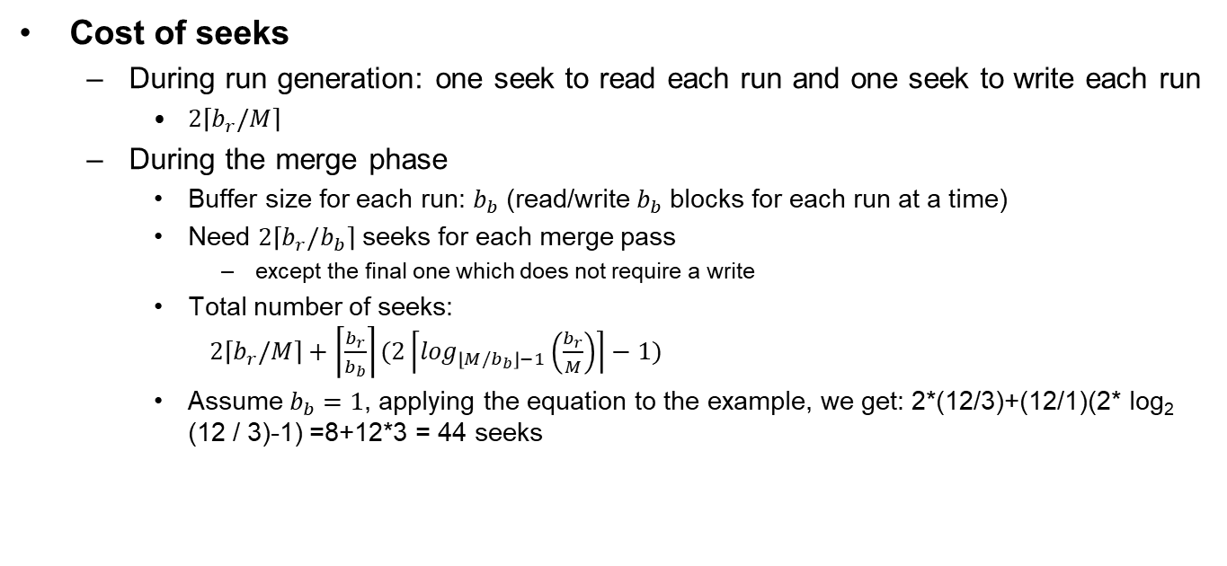
外排序-归并（续）
Cost of seeks
  During run generation: one seek to read each run and one seek to write each run
    $2\left\lceil b_{r}/M\right\rceil$
  During the merge phase
    Buffer size for each run: $b_{b}$ (read/write $b_{b}$ blocks for each run at a time)
    Need $2\left\lceil b_{r}/b_{b}\right\rceil$ seeks for each merge pass
      except the final one which does not require a write
    Total number of seeks:
    $2\left\lceil b_{r}/M\right\rceil +\left\lceil \frac{b_{r}}{b_{b}}\right\rceil (2\left\lceil \log_{\left\lfloor M/b_{b}\right\rfloor −1}\left(\frac{b_{r}}{M}\right)\right\rceil −1)$
    Assume $b_{b}=1$, applying the equation to the example, we get: 2*(12/3)+(12/1)(2* log₂ (12 / 3)-1) =8+12*3 = 44 seeks
Notes:
$2\left\lceil b_{r}/M\right\rceil 意味着$排序段生成的成本是单独计算的，而$\left\lceil \log_{\left\lfloor M/b_{b}\right\rfloor −1}\left(\frac{b_{r}}{M}\right)\right\rceil$因为向上取整，得到的值比归并的轮数多1，因此需要减去。

Slide 29
Outline
Overview
Measures of Query Cost
Selection Operation
Sorting
Join Operation
Other Operations
Evaluation of Expressions

Slide 30
Join Operation/连接运算
Algorithms to implement joins
  Nested-loop join (嵌套循环连接)
  Block nested-loop join (块嵌套循环连接)
  Indexed nested-loop join (索引嵌套循环连接)
  Merge-join* (归并连接)
  Hash-join* (散列连接)
Examples use the following information
  #records
    student: 5000
    takes: 10000
  #blocks
    student: 100
    takes: 400

Slide 31
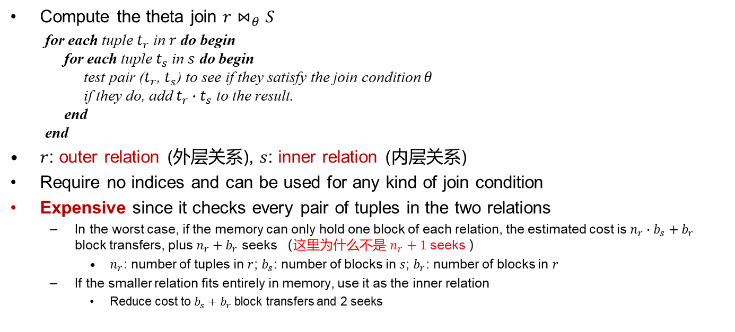
Nested-Loop Join (嵌套循环连接)
Compute the theta join $r⋈_{θ}S$
  for each tuple $t_{r}$ in $r$ do begin
  for each tuple $t_{s}$ in $s$ do begin
  test pair ($t_{r}$, $t_{s}$) to see if they satisfy the join condition $θ$
  if they do, add $t_{r}∙t_{s}$ to the result.
  end
  end
$r$: outer relation (外层关系), $s$: inner relation (内层关系)
Require no indices and can be used for any kind of join condition
Expensive since it checks every pair of tuples in the two relations
  In the worst case, if the memory can only hold one block of each relation, the estimated cost is $n_{r}∙b_{s}+b_{r}$ block transfers, plus $n_{r}+b_{r}$ seeks （这里为什么不是 $n_{r}+1$ seeks ）
    $n_{r}$: number of tuples in $r$; $b_{s}$: number of blocks in $s$; $b_{r}$: number of blocks in $r$
  If the smaller relation fits entirely in memory, use it as the inner relation
    Reduce cost to $b_{s}+b_{r}$ block transfers and 2 seeks
Notes:
回答红字问题，因为每次在搜索$b_{s}个$块的时候，磁盘指针动过了。

Slide 32
Nested-Loop Join (Cont.)
Given the worst case memory availability, the cost estimate is
  5,000 * 400 + 100 = 2,000,100 disk accesses with student as outer relation, and 5,000 + 100 = 5,100 seeks
  10,000 * 100 + 400 = 1,000,400 disk accesses with takes as the outer relation, and 10,000+400 = 10,400 seeks
  较小的关系做外层更优
  If smaller relation (student) fits entirely in memory, the cost estimate will be 500 disk accesses，这时较小的关系做内层更优
#records
student: 5000
takes: 10000
#blocks
student: 100
takes: 400

Slide 33
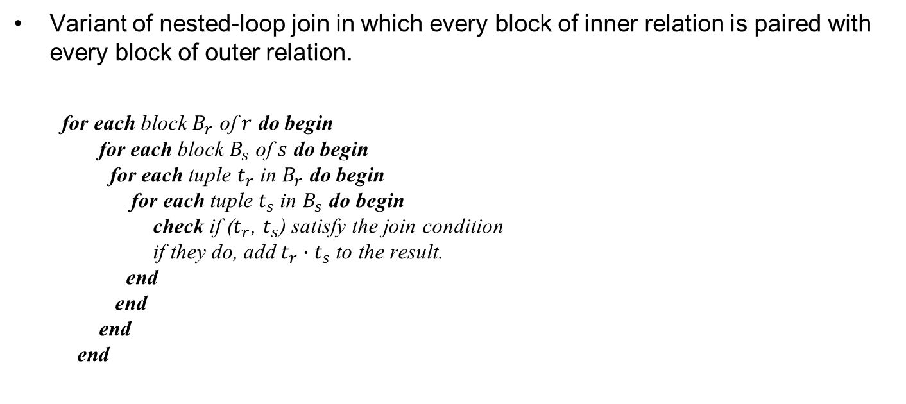
Block Nested-Loop Join (块嵌套循环连接)
Variant of nested-loop join in which every block of inner relation is paired with every block of outer relation.
  for each block $B_{r}$ of $r$ do begin
  for each block $B_{s}$ of $s$ do begin
  for each tuple $t_{r}$ in $B_{r}$ do begin
  for each tuple $t_{s}$ in $B_{s}$ do begin
  check if ($t_{r}$, $t_{s}$) satisfy the join condition
  if they do, add $t_{r}∙t_{s}$to the result.
  end
  end
  end
  end

Slide 34
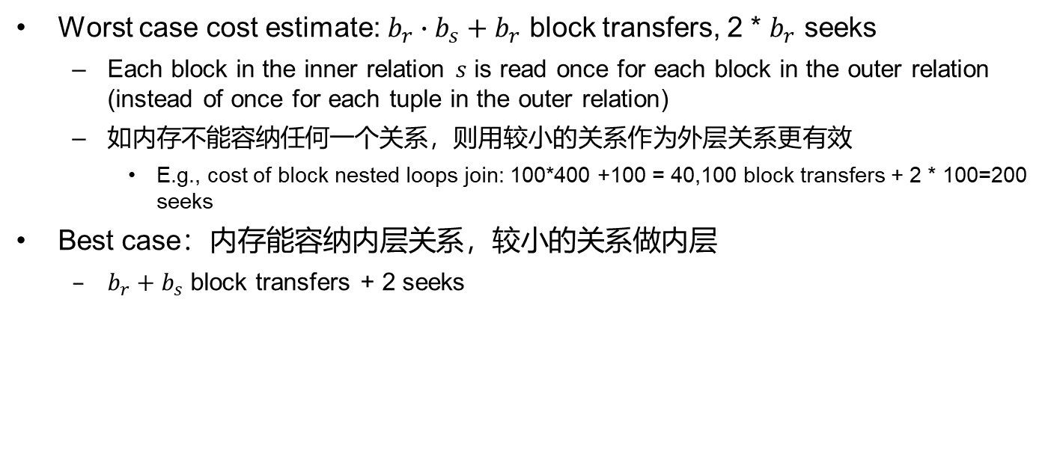
Block Nested-Loop Join (Cont.)
Worst case cost estimate: ${b_{r}∙b}_{s}+b_{r}$ block transfers, 2 * $b_{r}$ seeks
  Each block in the inner relation $s$ is read once for each block in the outer relation (instead of once for each tuple in the outer relation)
  如内存不能容纳任何一个关系，则用较小的关系作为外层关系更有效
    E.g., cost of block nested loops join: 100*400 +100 = 40,100 block transfers + 2 * 100=200 seeks
Best case：内存能容纳内层关系，较小的关系做内层
  $b_{r}+b_{s}$ block transfers + 2 seeks
#records
student: 5000
takes: 10000
#blocks
student: 100
takes: 400

Slide 35
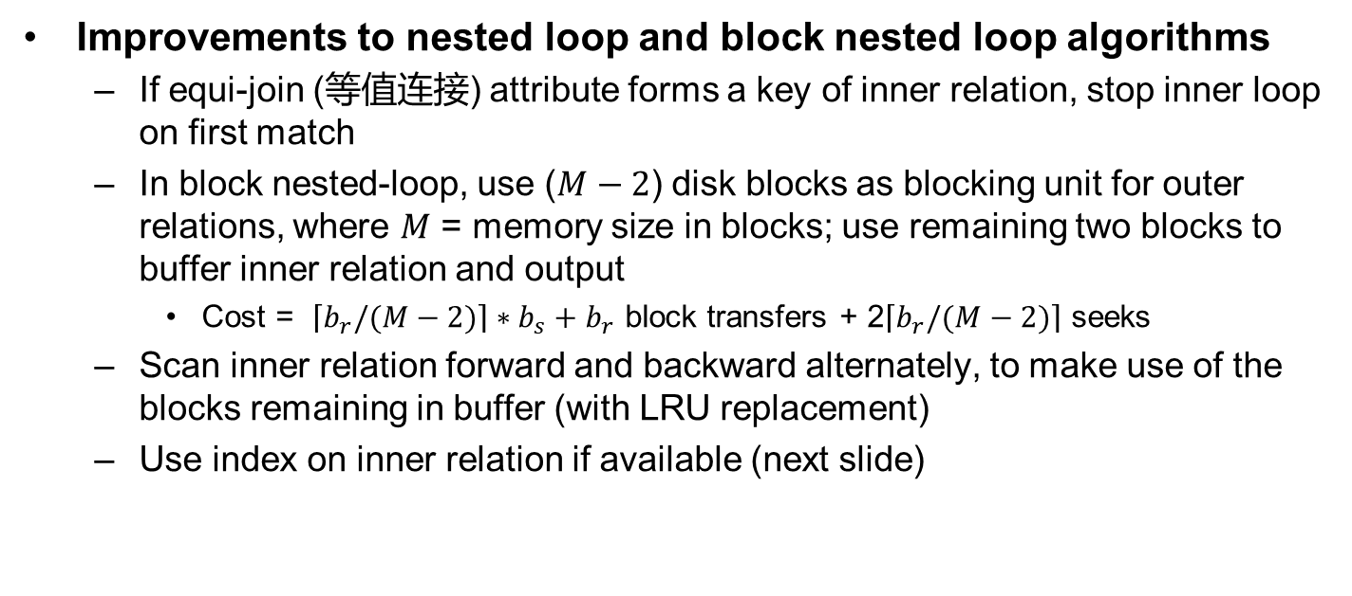
Block Nested-Loop Join (Cont.)
Improvements to nested loop and block nested loop algorithms
  If equi-join (等值连接) attribute forms a key of inner relation, stop inner loop on first match
  In block nested-loop, use ($M−2$) disk blocks as blocking unit for outer relations, where $M$ = memory size in blocks; use remaining two blocks to buffer inner relation and output
    Cost = $\left\lceil b_{r}/(M−2)\right\rceil ∗b_{s}+b_{r}$ block transfers + 2$\left\lceil b_{r}/(M−2)\right\rceil$ seeks
  Scan inner relation forward and backward alternately, to make use of the blocks remaining in buffer (with LRU replacement)
  Use index on inner relation if available (next slide)
Notes:
LRU(Least Recently Used)

Slide 36
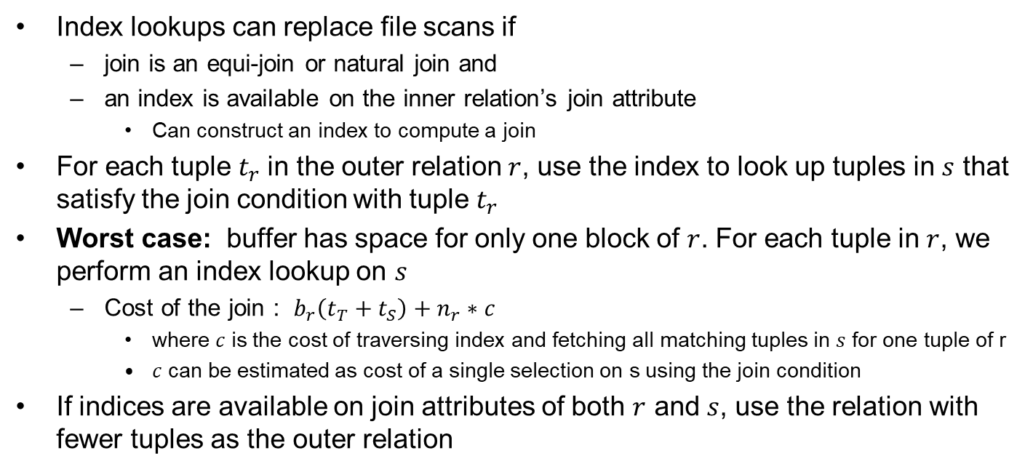
Indexed Nested-Loop Join (索引嵌套循环连接)
Index lookups can replace file scans if
  join is an equi-join or natural join and
  an index is available on the inner relation’s join attribute
    Can construct an index to compute a join
For each tuple $t_{r}$in the outer relation $r$, use the index to look up tuples in $s$ that satisfy the join condition with tuple $t_{r}$
Worst case: buffer has space for only one block of $r$. For each tuple in $r$, we perform an index lookup on $s$
  Cost of the join : $b_{r}\left(t_{T}+t_{S}\right)+n_{r}∗c$
    where $c$ is the cost of traversing index and fetching all matching tuples in $s$ for one tuple of r
    $c$ can be estimated as cost of a single selection on s using the join condition
If indices are available on join attributes of both $r$ and $s$, use the relation with fewer tuples as the outer relation

Slide 37
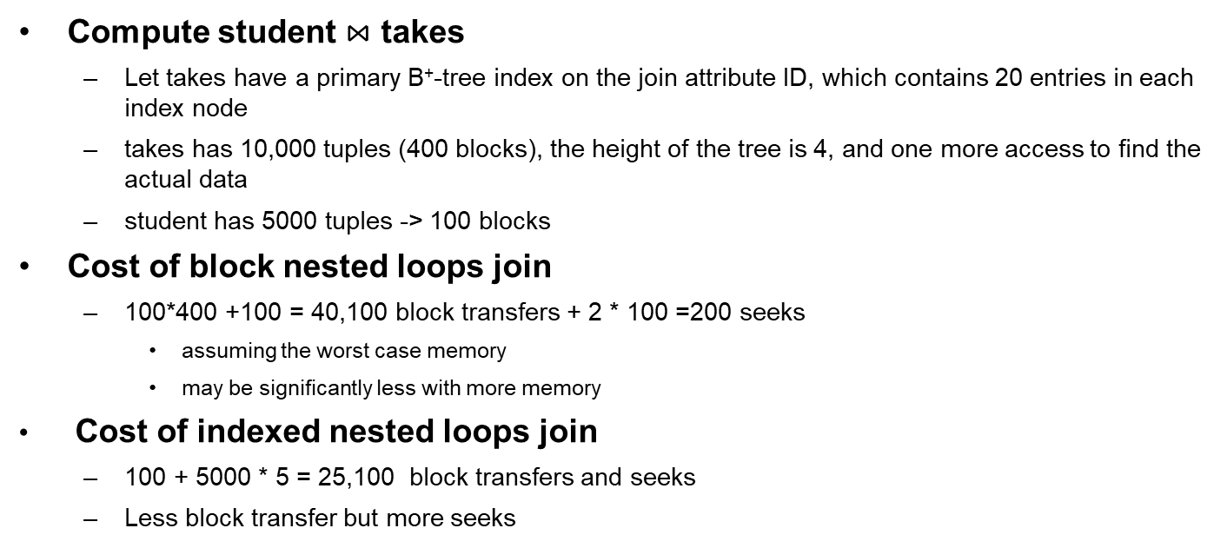
Example of Indexed Nested-Loop Join Costs
Compute student $⋈$ takes
  Let takes have a primary B⁺-tree index on the join attribute ID, which contains 20 entries in each index node
  takes has 10,000 tuples (400 blocks), the height of the tree is 4, and one more access to find the actual data
  student has 5000 tuples -> 100 blocks
Cost of block nested loops join
  100*400 +100 = 40,100 block transfers + 2 * 100 =200 seeks
    assuming the worst case memory
    may be significantly less with more memory
Cost of indexed nested loops join
  100 + 5000 * 5 = 25,100 block transfers and seeks
  Less block transfer but more seeks
#records
student: 5000
takes: 10000
#blocks
student: 100
takes: 400

Slide 38
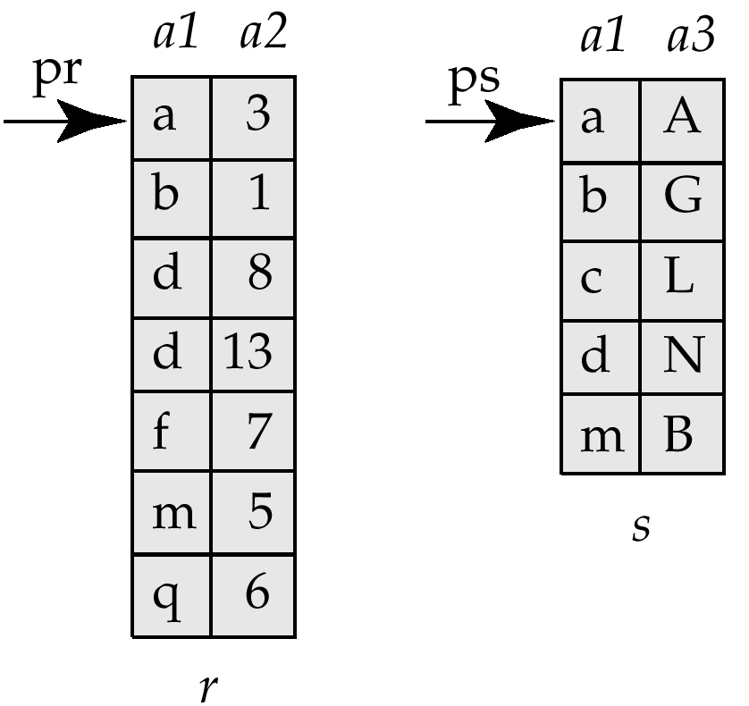
Merge-Join* (归并连接)
Sort both relations on their join attribute (if not already sorted on the join attributes)
Merge the sorted relations to join them
  Join step is similar to the merge stage of the sort-merge algorithm
  Main difference is handling of duplicate values in join attribute - every pair with same value on join attribute must be matched

Slide 39
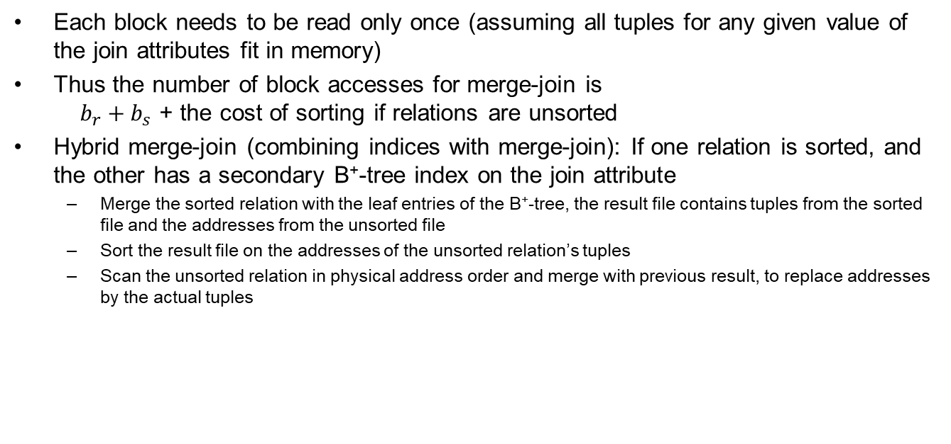
Merge-Join* (Cont.)
Each block needs to be read only once (assuming all tuples for any given value of the join attributes fit in memory)
Thus the number of block accesses for merge-join is
$b_{r}+b_{s}$ + the cost of sorting if relations are unsorted
Hybrid merge-join (combining indices with merge-join): If one relation is sorted, and the other has a secondary B⁺-tree index on the join attribute
  Merge the sorted relation with the leaf entries of the B⁺-tree, the result file contains tuples from the sorted file and the addresses from the unsorted file
  Sort the result file on the addresses of the unsorted relation’s tuples
  Scan the unsorted relation in physical address order and merge with previous result, to replace addresses by the actual tuples

Slide 40
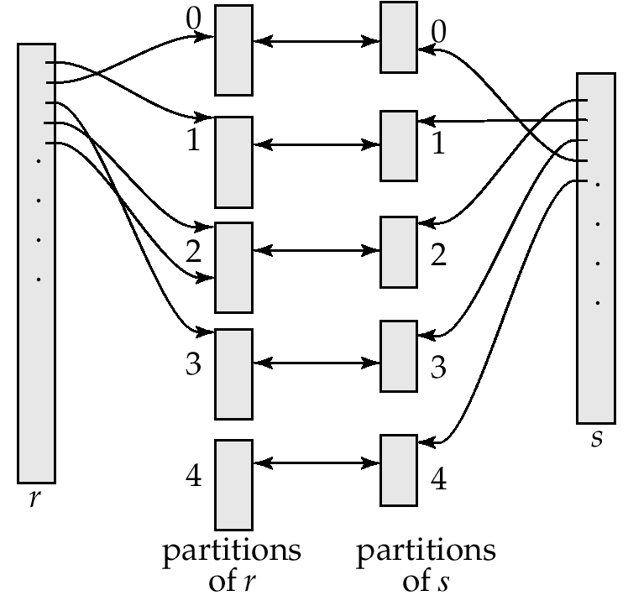
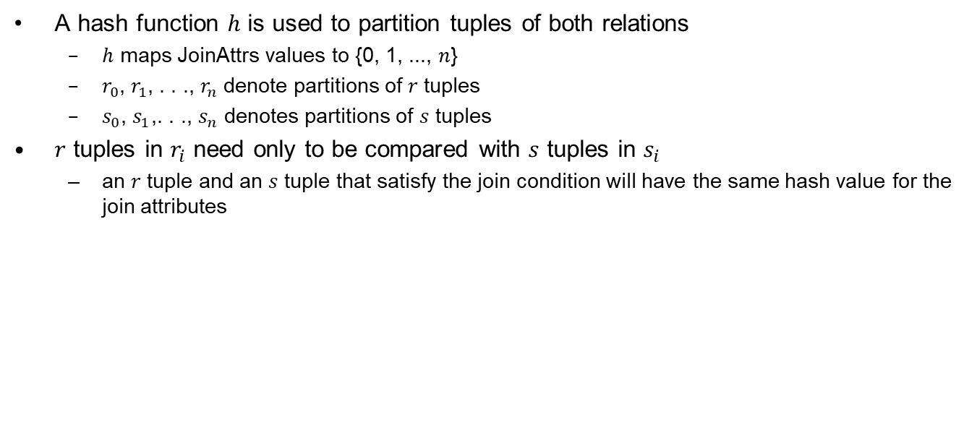
Hash-Join* (散列连接)
A hash function $h$ is used to partition tuples of both relations
  $h$ maps JoinAttrs values to {0, 1, ..., $n$}
  $r_{0}$, $r_{1}$, . . ., $r_{n}$ denote partitions of $r$ tuples
  $s_{0}$, $s_{1}$,. . ., $s_{n}$ denotes partitions of $s$ tuples
$r$ tuples in $r_{i}$ need only to be compared with $s$ tuples in $s_{i}$
  an $r$ tuple and an $s$ tuple that satisfy the join condition will have the same hash value for the join attributes

Slide 41

Hash-Join*
The hash-join of $r$ and $s$ is computed as follows
1. Partition the relation s using hashing function h. When partitioning a relation, one block of memory is reserved as the output buffer for each partition.
2. Partition r similarly.
3. For each i:
  (a) Load s_{i} into memory and build an in-memory hash index on it using the join attribute. This hash index uses a different hash function than the earlier one h.
  (b) Read the tuples in r_{i} from the disk one by one. For each tuple t_{r} locate each matching tuple t_{s} in s_{i} using the in-memory hash index. Output the concatenation of their attributes.
Relation $s$ is called the build input(构造用输入) and $r$ is called the probe input(探查用输入)

Slide 42
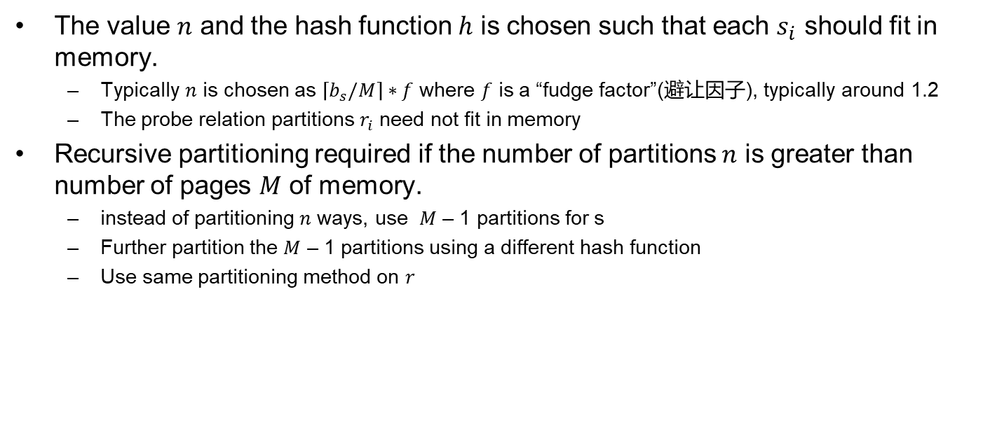
Hash-Join* (Cont.)
The value $n$ and the hash function $h$ is chosen such that each $s_{i}$ should fit in memory.
  Typically $n$ is chosen as $\left\lceil b_{s}/M\right\rceil ∗f$ where $f$ is a “fudge factor”(避让因子), typically around 1.2
  The probe relation partitions $r_{i}$ need not fit in memory
Recursive partitioning required if the number of partitions $n$ is greater than number of pages $M$ of memory.
  instead of partitioning $n$ ways, use $M$ – 1 partitions for s
  Further partition the $M$ – 1 partitions using a different hash function
  Use same partitioning method on $r$

Slide 43
Handling of Overflows
Hash-table overflow occurs in partition si if si does not fit in memory. Reasons could be
  Many tuples in s with same value for join attributes
  Bad hash function
Overflow resolution(溢出分解) can be done in build phase（构造阶段）
  Partition si is further partitioned using different hash function.
  Partition ri must be similarly partitioned.
Overflow avoidance(溢出避免) performs partitioning carefully to avoid overflows during build phase
  E.g. partition build relation into many partitions, then combine them
Both approaches fail with large numbers of duplicates(大量元组链接属性相同)
  Fallback option: use block nested loops join on overflowed partitions

Slide 44
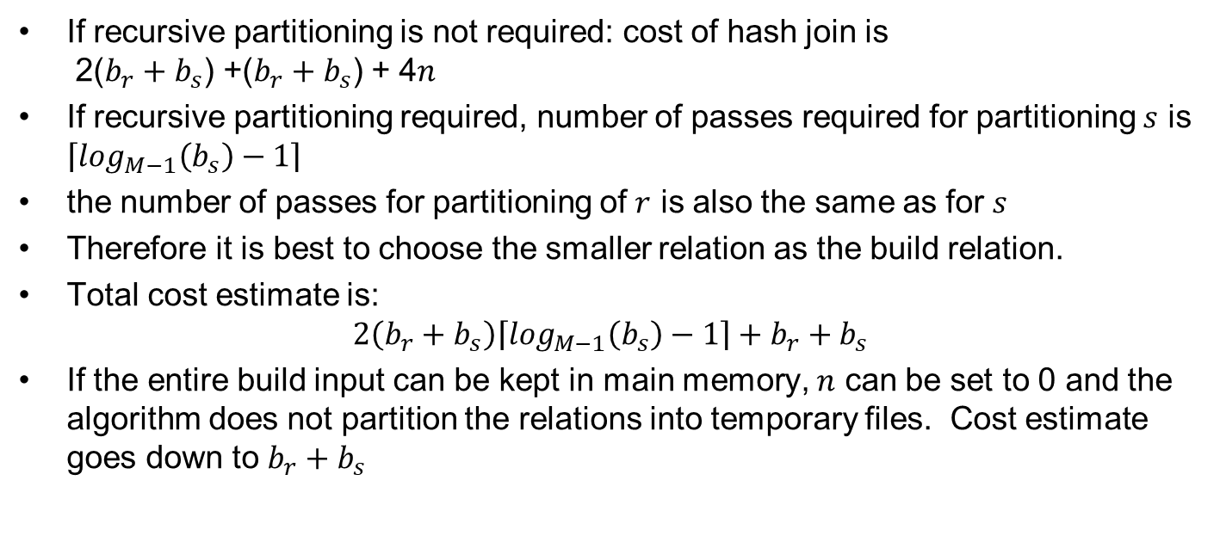
Cost of Hash-Join
If recursive partitioning is not required: cost of hash join is
2($b_{r}+b_{s}$) +($b_{r}+b_{s}$) + 4$n$
If recursive partitioning required, number of passes required for partitioning $s$ is $\left\lceil \log_{M−1}\left(b_{s}\right)−1\right\rceil$
the number of passes for partitioning of $r$ is also the same as for $s$
Therefore it is best to choose the smaller relation as the build relation.
Total cost estimate is:
$$2\left(b_{r}+b_{s}\right)\left\lceil \log_{M−1}\left(b_{s}\right)−1\right\rceil +b_{r}+b_{s}$$
If the entire build input can be kept in main memory, $n$ can be set to 0 and the algorithm does not partition the relations into temporary files. Cost estimate goes down to $b_{r}+b_{s}$

Slide 45

Example of Cost of Hash-Join
customer $⋈$ depositor
Assume that memory size is 20 blocks
b_{depositor}= 100 and b_{customer} = 400.
depositor is to be used as build input. Partition it into five partitions, each of size 20 blocks. This partitioning can be done in one pass.
Similarly, partition customer into five partitions, each of size 80. This is also done in one pass.
Therefore total cost: 3(100 + 400) = 1500 block transfers
  ignores cost of writing partially filled blocks

Slide 46
Hybrid Hash–Join
Useful when memory sized are relatively large, and the build input is bigger than memory.
Main feature of hybrid hash join: Keep the first partition of the build relation in memory.
E.g. With memory size of 25 blocks, depositor can be partitioned into five partitions, each of size 20 blocks.
Division of memory:
  The first partition occupies 20 blocks of memory（无需递归划分）
  1 block is used for input, and 1 block each for buffering the other 4 partitions.

Slide 47

Hybrid Hash–Join
customer is similarly partitioned into five partitions each of size 80; the first is used right away for probing, instead of being written out and read back.
Cost of 3(80 + 320) + 20 +80 = 1300 block transfers for hybrid hash join, instead of 1500 with plain hash-join.
Hybrid hash-join most useful if $M≫\sqrt{b_{s}}$
Notes:
20 s_0+80 r_0没有写回和读入，因此比其它划分要少一次写一次读。参考12.5.5.4中第一个公式

Slide 48
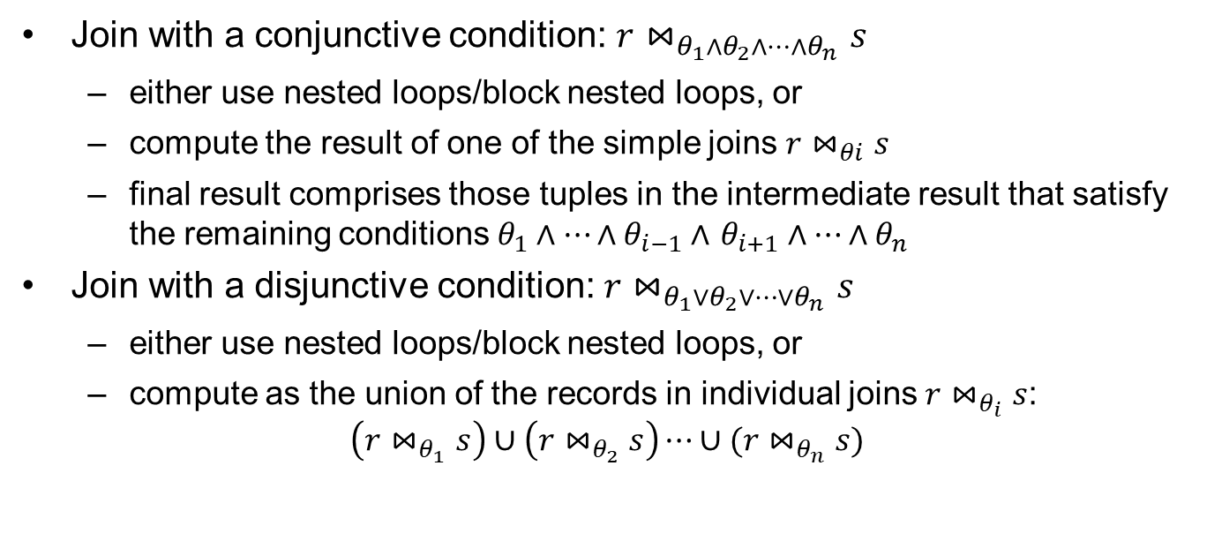
Complex Joins
Join with a conjunctive condition: $r⋈_{θ_{1}∧θ_{2}∧…∧θ_{n}}s$
  either use nested loops/block nested loops, or
  compute the result of one of the simple joins $r⋈_{θi}s$
  final result comprises those tuples in the intermediate result that satisfy the remaining conditions $θ_{1}∧…∧θ_{i−1}∧$ $θ_{i+1}∧…∧θ_{n}$
Join with a disjunctive condition: $r⋈_{θ_{1}∨θ_{2}∨…∨θ_{n}}s$
  either use nested loops/block nested loops, or
  compute as the union of the records in individual joins $r⋈_{θ_{i}}s$:
$$\left(r⋈_{θ_{1}}s\right)∪\left(r⋈_{θ_{2}}s\right)⋯∪(r⋈_{θ_{n}}s)$$

Slide 49
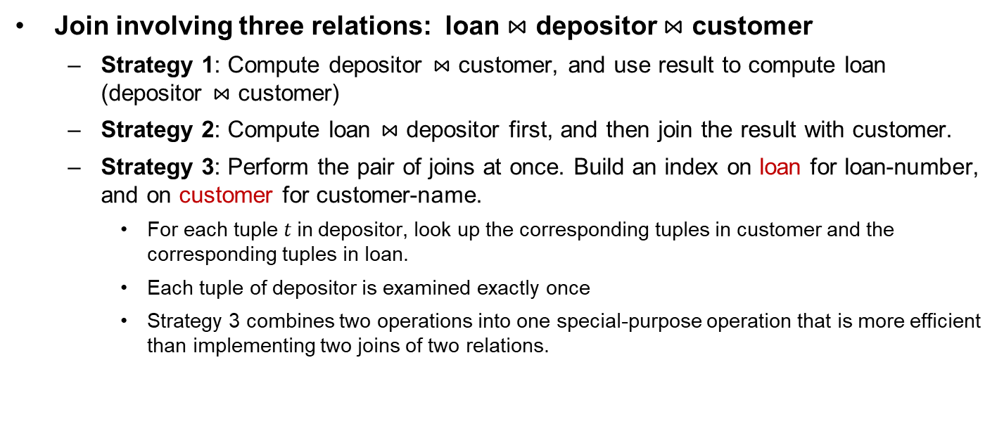
Complex Joins
Join involving three relations: loan $⋈$ depositor $⋈$ customer
  Strategy 1: Compute depositor $⋈$ customer, and use result to compute loan (depositor $⋈$ customer)
  Strategy 2: Compute loan $⋈$ depositor first, and then join the result with customer.
  Strategy 3: Perform the pair of joins at once. Build an index on loan for loan-number, and on customer for customer-name.
    For each tuple $t$in depositor, look up the corresponding tuples in customer and the corresponding tuples in loan.
    Each tuple of depositor is examined exactly once
    Strategy 3 combines two operations into one special-purpose operation that is more efficient than implementing two joins of two relations.

Slide 50
Outline
Overview
Measures of Query Cost
Selection Operation
Sorting
Join Operation
Other Operations
Evaluation of Expressions

Slide 51
Duplicate Elimination & Projection
Duplicate elimination can be implemented via hashing or sorting
  On sorting duplicates will come adjacent to each other, and all but one copy of duplicates can be deleted
  Optimization: duplicates can be deleted during run generation as well as at intermediate merge steps in external sort-merge
  Hashing is similar – duplicates will come into the same bucket
Projection is implemented by performing projection on each tuple followed by duplicate elimination

Slide 52
Aggregation
Implemented in a manner similar to duplicate elimination
  Sorting or hashing can be used to bring tuples in the same group together, and then the aggregate functions can be applied on each group
  Optimization: combine tuples in the same group during run generation and intermediate merges, by computing partial aggregate values
    For count, min, max, sum: keep aggregate values on tuples found so far in the group.
    For avg, keep sum and count, and divide sum by count at the end

Slide 53
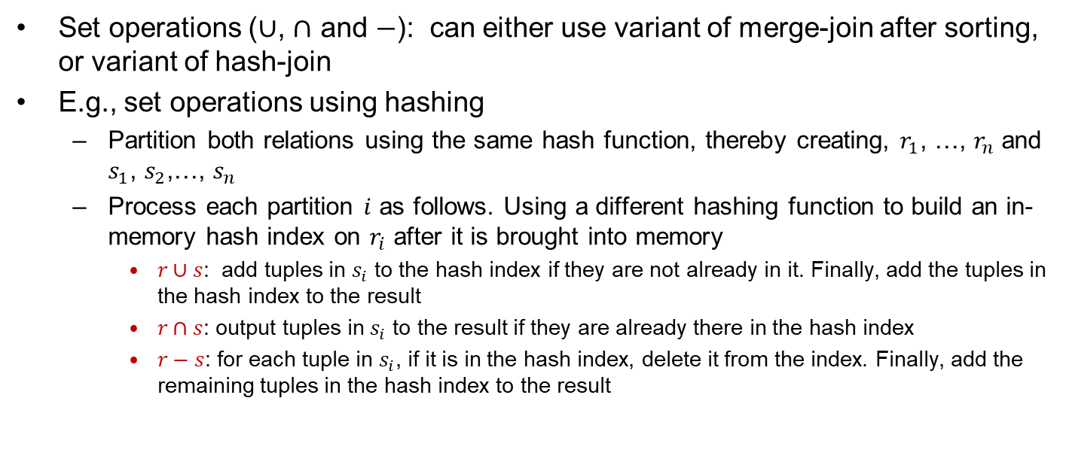
Set Operations
Set operations ($∪$, $∩$ and $−$): can either use variant of merge-join after sorting, or variant of hash-join
E.g., set operations using hashing
  Partition both relations using the same hash function, thereby creating, $r_{1}$, …, $r_{n}$ and $s_{1}$, $s_{2}$,…, $s_{n}$
  Process each partition $i$ as follows. Using a different hashing function to build an in-memory hash index on $r_{i}$ after it is brought into memory
    $r∪s$: add tuples in $s_{i}$ to the hash index if they are not already in it. Finally, add the tuples in the hash index to the result
    $r∩s$: output tuples in $s_{i}$ to the result if they are already there in the hash index
    $r−s$: for each tuple in $s_{i}$, if it is in the hash index, delete it from the index. Finally, add the remaining tuples in the hash index to the result

Slide 54
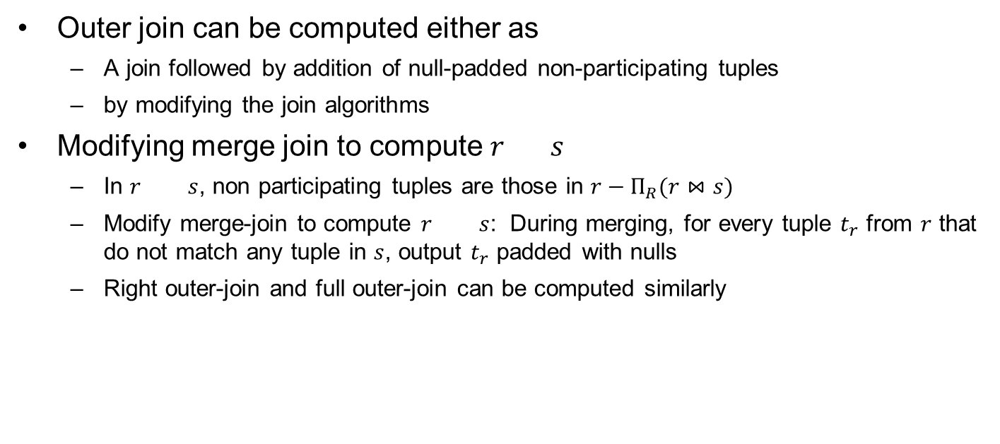
Outer Join
Outer join can be computed either as
  A join followed by addition of null-padded non-participating tuples
  by modifying the join algorithms
Modifying merge join to compute $r s$
  In $r s$, non participating tuples are those in $r−Π_{R}(r⋈s)$
  Modify merge-join to compute $r s$: During merging, for every tuple $t_{r}$ from $r$ that do not match any tuple in $s$, output $t_{r}$ padded with nulls
  Right outer-join and full outer-join can be computed similarly

Slide 55
Outline
Overview
Measures of Query Cost
Selection Operation
Sorting
Join Operation
Other Operations
Evaluation of Expressions

Slide 56
Evaluation of Expressions
We have seen the algorithms for individual operations
Alternatives for evaluating an entire expression tree
  Materialization (物化): generate the results of an expression and materialize (store) the results on disk
  Pipelining (流水线): pass on tuples to parent operations even as an operation is being executed

Slide 57
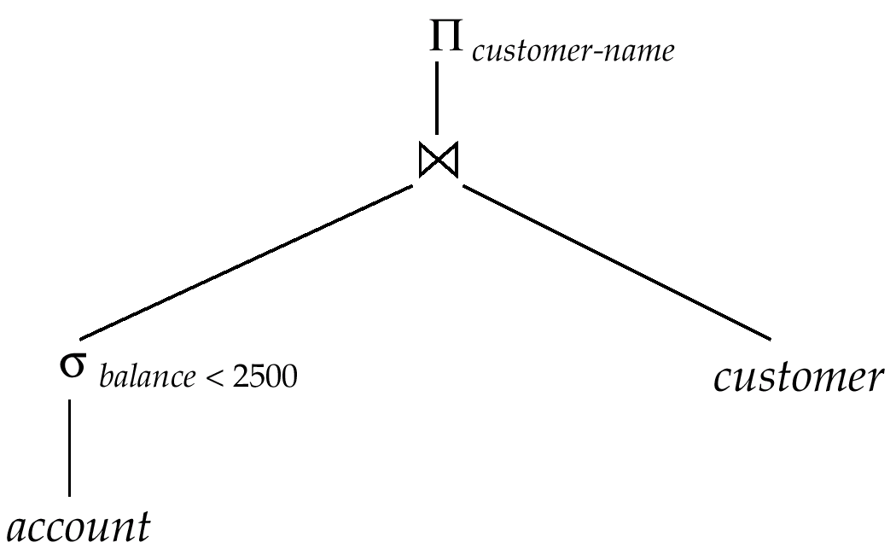

Materialization (物化)
Materialized evaluation (物化计算) : evaluate one operation at a time, starting from the lowest level
E.g., for the figure below, compute and store
$$σ_{balance<2500}(account)$$
compute and store the previous result then join with customer, and finally compute the projections on customer-name.
Notes:
Operator tree : 运算符树

Slide 58
Materialization (Cont.)
Materialized evaluation (物化计算) is always applicable
The cost of writing the results to disk and reading them back can be quite high
  overall cost = sum of costs of individual operations + cost of writing intermediate results to disk
Double buffering (双缓冲): use two output buffers for each operation, when one is full write it to disk while the other is getting filled
  Reduce the execution time

Slide 59
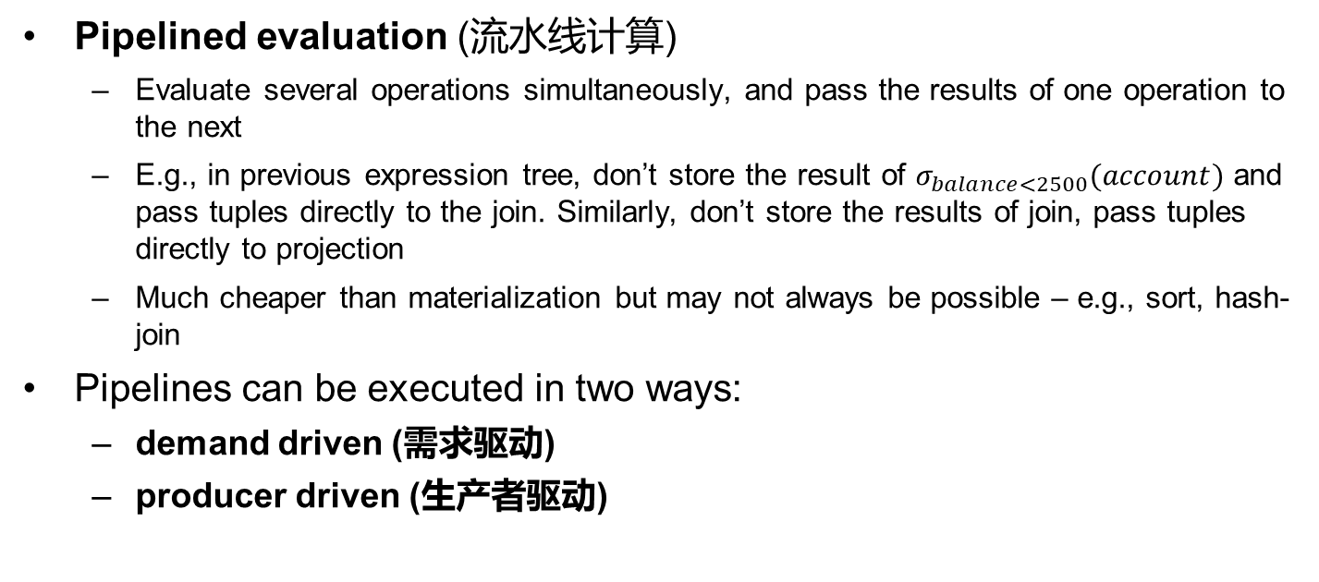
Pipelining (流水线)
Pipelined evaluation (流水线计算)
  Evaluate several operations simultaneously, and pass the results of one operation to the next
  E.g., in previous expression tree, don’t store the result of $σ_{balance<2500}(account)$ and pass tuples directly to the join. Similarly, don’t store the results of join, pass tuples directly to projection
  Much cheaper than materialization but may not always be possible – e.g., sort, hash-join
Pipelines can be executed in two ways:
  demand driven (需求驱动)
  producer driven (生产者驱动)

Slide 60
Pipelining (Cont.)
demand driven or lazy evaluation
  System repeatedly requests next tuple from top level operation
  Each operation requests next tuple from children operations as required, in order to output its next tuple
  Between calls, operation has to maintain “state” so it knows what to return next
  Each operation is implemented as an iterator implementing the following operations
Producer-driven or eager pipelining
  Operators produce tuples eagerly and pass them up to their parents
    Buffer maintained between operators, child puts tuples in buffer, and parent reads tuples from buffer
    If buffer is full, child waits till there is space in the buffer, and then generates more tuples

Slide 61
End of Chapter 15

